Slide 1
1Sfia Project
Game Library
Paulo Silva

Slide 2
Contents
Project Description
Tools Used
Quick Demo
Questions

Slide 3
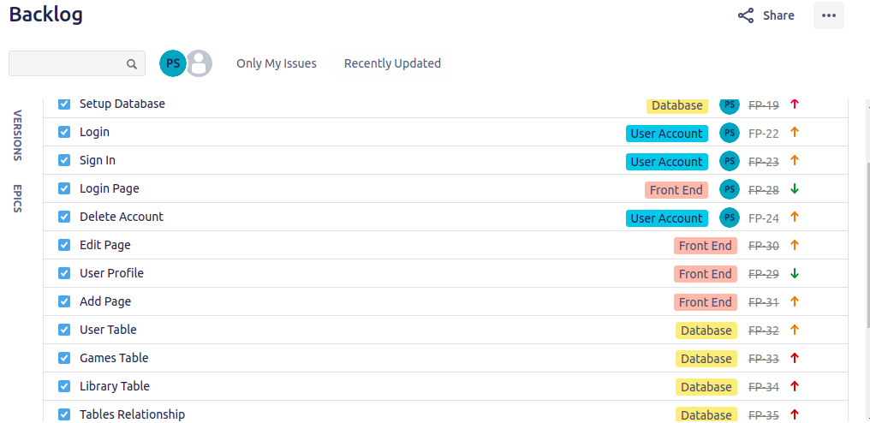
Planning

Slide 4
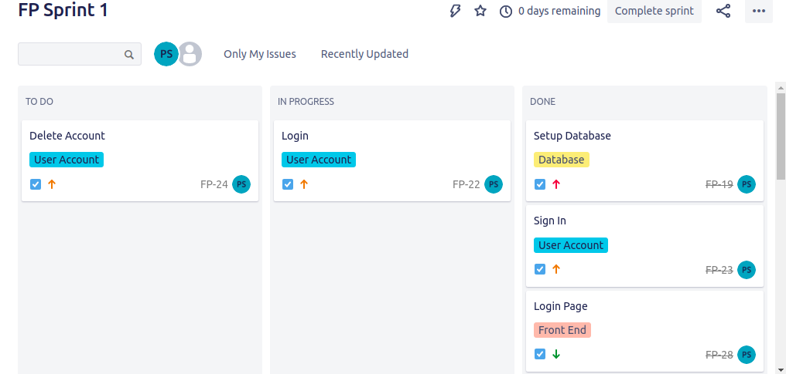
Planning

Slide 5
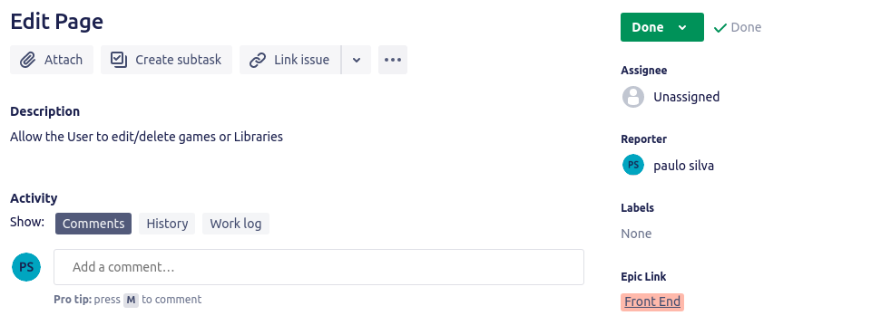
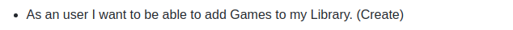
Planning

Slide 6
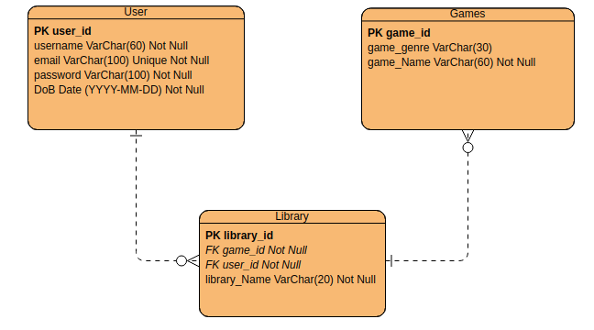
Planning

Slide 7
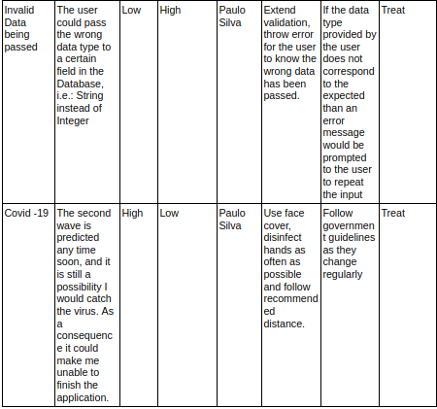
Risk Assessment

Slide 8
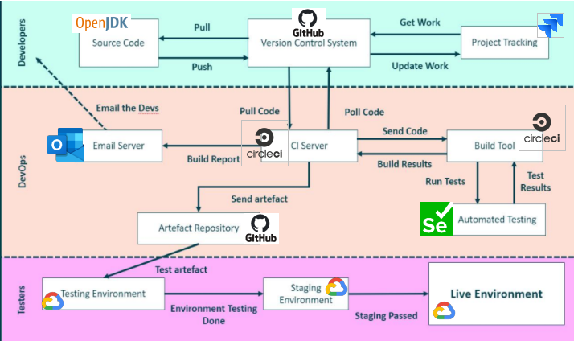
CI Pipeline

Slide 9
DEMO

Slide 10
Summary
Successful outcome: stable version of the application.
Problem: Login feature of the application.
Possible improvement: Set a better MVP.
What was learned: How to create a spring application, and properly structure a project.

Slide 11
Q&A

